Slide 1
Iterator & List Iterator
Traversing through collection framework

Slide 2
Topics that will be covered:
What is iterator and list iterator?
Add your second bullet point here
Add your third bullet point here

Slide 3
Traversing through Collection:
Iteration: Continual repeating of something.
What java structure fits this description?
Loops are iteration structure.
Why don’t we use for-each loop for traversing?
Because in for-each, we can’t modify collection.
It will throw a ConcurrentModificationException.
For-each loop implicitly creates an iterator but it is not exposed to the user.

Slide 4
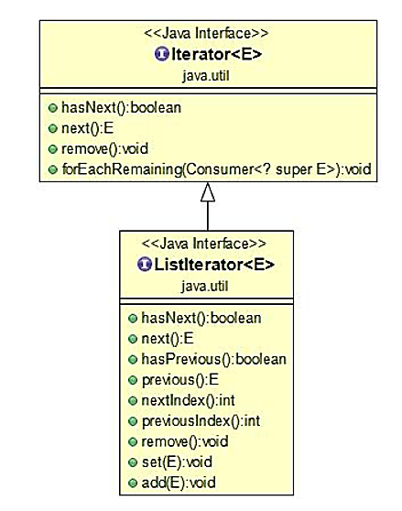
What is Iterator & ListIterator?

Slide 5
Difference between Iterator & ListIterator
Iterator
ListIterator
Can do remove operation only on elements
Can be for all collection classes.
Traverse in only forward direction.
Cannot obtain indexes while using Iterator.
Can remove, add & replace elements.
Available for those collections that implement List interface.
Traverse in both directions i.e. forward & backward.
Can obtain indexes at any point of time while traversing a list using ListIterator.

Slide 7
Add a Slide Title - 5

